Slide 1
Microcontrollers & Electronics Basics OR…
EPICS
∨
PIMP MY PROJECT

Slide 2
Why Learn this?

Slide 3
Arduino Microcontroller
A computer for the physical world.
Able to read INPUTS – light on a sensor, a finger on a button, or a Twitter message.
Turn it into OUTPUTS – activating a motor, turning on an LED, publishing something online.
Tell your Arduino what to do using the Arduino programming language.
www.arduino.cc
Uses information from INPUTS to control various OUTPUTS.

Slide 4
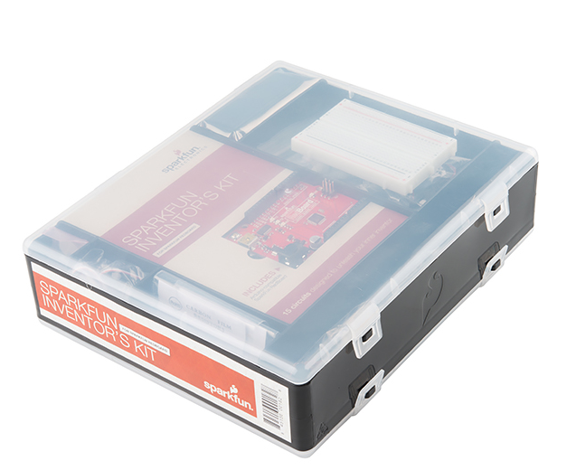
Redboard Microcontroller
Sparkfun’s version of Arduino.
Uses same programming language and electrical components as Arduino.
Sparkfun offers a lot of cool tutorials and project ideas. Visit their website:
www.sparkfun.com
We have a handful of Sparkfun Inventor’s Kits for checkout in the EPICS workshop that have everything you need to get started building cool stuff.

Slide 5
6
8
5
7
2
4
3
9
1
10

Slide 6
Arduino Uno
Power In (Barrel Jack): Can be used with either a 9V or 12V wall-wart or battery
Power In (USB Port): Provides power and communicates with your board when plugged into your computer via USB.
LED (RX: Receiving): Lights up when the Arduino is receiving data (such as when being programmed).
LED (TX: Transmitting): Lights up when your Arduino is transmitting data (such as when running a program).
LED (Pin 13: Troubleshooting): LED is incorporated into your sketch to show if your program is running properly.
Pins (ARef, Ground, Digital, Rx, Tx): Used for inputs, outputs, power, and ground.
LED (Indicates Arduino is ON): Simple power indicator LED.
Reset button: Used to manually reset Arduino, which makes code restart.
ICSP Pins: For “in-circuit serial programming,” used if you want to bypass the bootloader.
Pins (Analog In, Power In, Ground, Power Out, Reset): Used for inputs, outputs, power, and ground.

Slide 7
downLoad Arduino IDE (Integrated Development Environment)
arduino.cc/en/main/software

Slide 8
Connect RedBoard to your Computer

Slide 9
Install Arduino Drivers

Slide 10
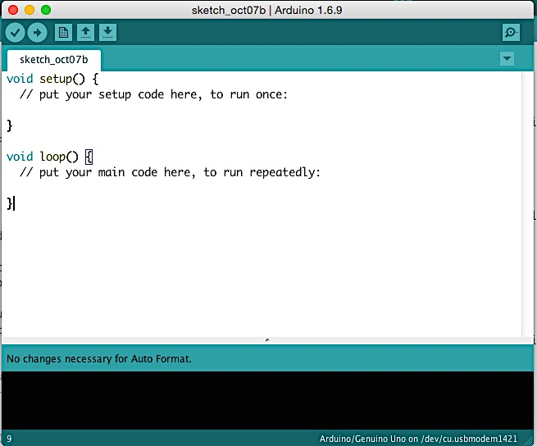
OPEN arduino ide

Slide 11
Select your Board

Slide 12
Select Serial Device (Windows)

Slide 13
Select Serial Device (Mac)

Slide 14
DOWNLOAD Code

Slide 15
KNOW the Arduino GUI
Verify: Compiles and approves your code. Will catch errors in syntax.

Slide 16
KNOW the Arduino GUI
Upload: Sends your code to the RedBoard. When you click it you should see lights on your board blink rapidly.

Slide 17
KNOW the Arduino GUI
New: Opens up a new code window tab.

Slide 18
KNOW the Arduino GUI
Open: Open an existing sketch, which is where you write your code.

Slide 19
KNOW the Arduino GUI
Save: Saves the currently open sketch.

Slide 20
KNOW the Arduino GUI
Serial Monitor: Opens a window that displays any serial info the RedBoard is transmitting. Very useful for debugging.
What is Serial?
Process of sending data one bit (0 or 1) at a time.

Slide 21
KNOW the Arduino GUI
Sketch Name: Name of the sketch you are currently working on.

Slide 22
KNOW the Arduino GUI
Code Area: Area where you compose the code for your sketch.

Slide 23
KNOW the Arduino GUI
Message Area: Where the IDE tells you if there were any errors in your code.

Slide 24
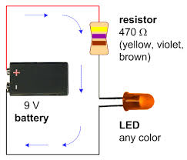
What is a Circuit?
Electricity running in a loop with a starting point and ending point – and a number of components in between.
Can include resistors, diodes, inductors, sensors of all shapes and sizes, motors, and hundreds of thousands of other components.
OHM’S LAW
Voltage = Current x Resistance
V = IR
Voltage is measured in VOLTS (V)
Current is measured in AMPERES (A)
Resistance is measured in OHMS (Ω)
The LED above needs 20 mA (milliamps) of current. What size resistor should you use?
Notes:
Answer: 450 ohms

Slide 25
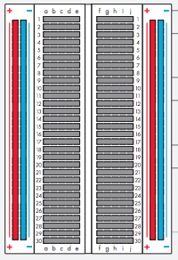
breadboard
How it looks
How it’s connected
Connect power to the + vertical columns
Connect ground down the - vertical columns
Components placed along horizontal rows will be connected when power is running.
This line divides the board in half

Slide 26
Jumper Wire

Slide 27
330 Ω Resistor

Slide 28
10 kΩ Resistor

Slide 29
potentiometer

Slide 30
Light Emitting Diode (LED)

Slide 31
Photo Resistor

Slide 32
Temperature Sensor

Slide 33
Arduino Pins
Notes:
The five analog pins are used ONLY to input analog signals, which can take on a continuous range of values. These signals can vary between 0V and 5V.
The 13 digital pins are used to input OR output digital signals, which are either “on” or “off”. These signals will always be 5V (which we call “high”) or 0V (which we call “low”).
The Arduino has an analog-to-digital converter (ADC), which allows it to convert analog signals (such as temperature or light, which can take on a continuous range of values) into digital signals (such as blinking a light, which is either ON or OFF). The Arduino, however, does not have a digital-to-analog converter.
When you are writing your Arduino code, you have to specify whether the digital pins are either being used as input or output pins. You do not have to specify how the analog pins are being used because they can only be input pins.
In this workshop we will also use the pins for power (5V) and ground.

Slide 34
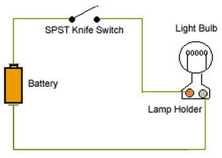
Analog vs digital signals
5V
0V
5V
0V
Learn more: https://www.youtube.com/watch?v=Z3rsO912e3I
Notes:
An analog signal is a signal that can have a huge range of values. These values are continuous, like a sine wave.
If you’re using a microcontroller that has a “logic level” of 5V, it has a base voltage of 0 (ground) and a maximum voltage of 5V. With this logic level, an analog signal can vary anywhere between these two levels.
Most things we deal with in the real world are analog. Consider a light sensor that is used to measure the intensity of sunlight. When configured in a “voltage divider circuit” (more on this later), the amount of sunlight that shines on the light sensor will change the voltage across the light resistor. No light might correspond to a 0V signal. Partial shade might correspond to a 2.5 V signal, and full light might correspond to a 5V signal. And there are many many values in between. It’s a CONTINUOUS SIGNAL.
Digital signals are different. They have one of two values – either HIGH or LOW. The way we often seen this represented is as a 1 or a 0. 1 representing HIGH or ON, and 0 representing LOW or OFF. So if we’re talking about the same 5V microcontroller that we were before, when we get a voltage close to 5, it corresponds to a 1, and when we get a voltage close to 0 it corresponds to a 0. An example in real life is just a simple light switch. When we close the switch, electricity from the battery will flow through and turn the light bulb on. A microcontroller would measure that as a 1 because it’s seeing the full voltage. If the switch is open it would register that as a 0.

Slide 35
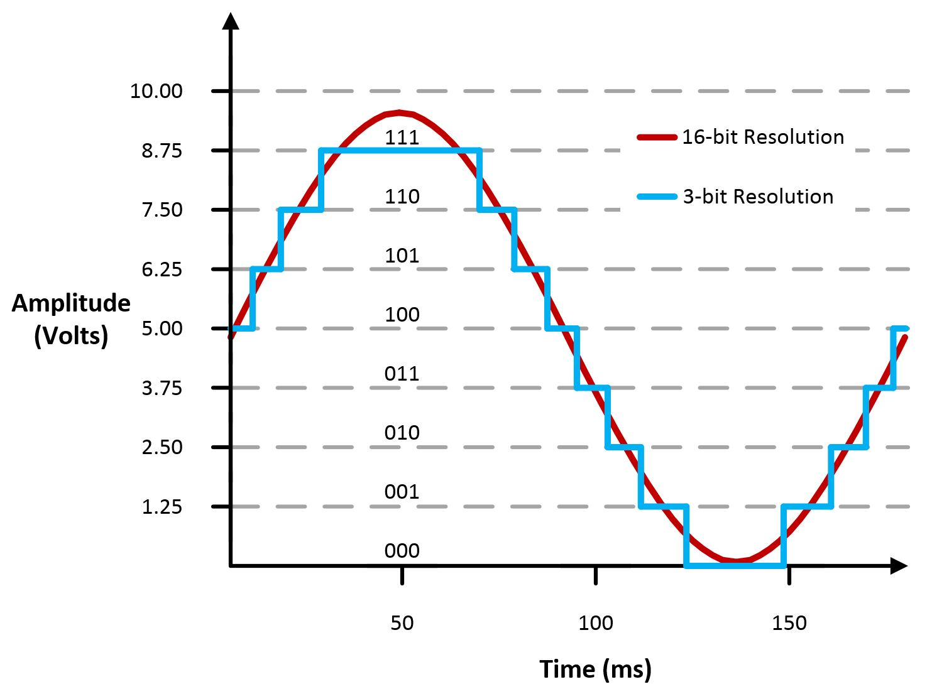
Analog to digital conversion
Need to convert analog signals to digital for processing.
Digital signal depends on the resolution of the analog-to-digital converter (ADC).
A 10-bit system will have 1,024 points of resolution.
2¹⁰ = 1,024
Why the number 2?
Because there are two options in a binary system (0 & 1).
Notes:
Since most everything in the world is analog, how do we convert between the two? How do we take an analog signal and convert it to a digital signal? That’s done with analog-to-digital converters.
Let’s say we have that analog signal from the light sensor coming into our system, which ranges from 0V – 5V. So now we need to convert that to a digital signal because that’s what our Arduino needs in order to process it. What our digital signal looks like is going to depend on the resolution of the analog to digital converter (ADC) in our system.
Basically our system’s resolution is based on the number of bits. If we have a 10 bit ADC, that’s going to be 2^10 bits because 2 is the number of options we have (0 or 1). That equals 1,024. So a 10-bit system is going to have 1024 bits of resolution. Generally we see 0 to 1023 because 0 registers as 0V. This is really important because when we use the “serial monitor” in Arduino to read the voltage from the analog input pins, we’ll read values between 0 and 1,023. So keep this in the back of your head as we move forward.
So - a 10 bit system will break our analog signal into 10 different horizontal steps. As the figure on the slide shows, a 3-bit system will break the analog signal into 3 bits, which we can easily see. With a 16-bit system, it’s hard to see the different steps, and the signal looks a whole lot smoother.

Slide 36
Analog to digital conversion
Arduino translates an analog input voltage into a number that ranges from 0 - 1,023.
Digital voltages are translated into a number that ranges from 0 – 255.
0
255

Slide 37
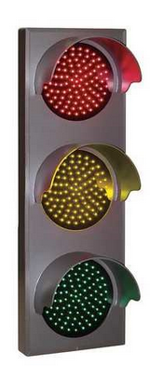
Circuit #1: Blinking an LED
LEDs (light emitting diodes) are small, powerful lights used in many different applications.
We’re going to learn how to blink an LED on and off.

Slide 38
Resistor Color Code

Slide 39
Circuit Schematic
Pin 13 is a digital pin and can be used as an output or an input. Here we will use it to output power to the LED.
Pin 13 will be connected to the positive lead on the LED.
The negative lead on the LED will be connected to one leg of the resistor.
The other leg of the resistor will be connected to ground to complete the circuit.
Note: These components are all in series (one after the other, like beads on a string).

Slide 40
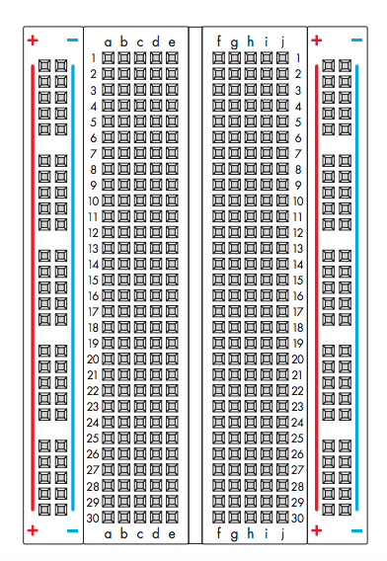
Design it!

Slide 42
Create the Sketch
/*
Blink
Turns on an LED for one second then off for one second, repeatedly.
*/
void setup() {
pinMode(13, OUTPUT);
}
void loop() {
digitalWrite(13, HIGH);
delay(1000);
digitalWrite(13, LOW);
delay(1000);
}
Notes:
Notes:
// Is how you make single-line comments in the sketch.
/* is how you make multi-line comments. Make sure the end of your comment ends with */
Notice the two functions setup() and loop (). All sketches must have these functions, which will run automatically when the sketch is uploaded. The setup() function runs only once when the sketch starts and is used for things you need to do first, or only once. In this case we are setting digital pin 13 to be an output, which means that it will output 0V and 5V (which will turn the LED off and on).
After setup() finishes, the loop() functions runs over and over until you turn off or reset your Arduino. This is where the bulk of your sketch will be. Here, this is where we will write the code to make the LED blink on and off.
Since we have an LED connected to pin 13, if we make the output HIGH, the LED will get voltage and light up. If we make the output LOW, the LED will have no voltage and will turn off. We use the function digitalWrite() to do this. It takes two values – a pin number followed by the word HIGH or LOW.
To make the LED show a blinking pattern, we have to use a delay so the LED stays on and off for a certain amount of time. We use the function delay() which takes one input – milliseconds. So delay(1000) would cause the program to pause for one second.
Experiment:
1. Make the LED blink more rapidly. Then more slowly.
2. Make a blinking pattern like short, short, long.
3. Determine how rapidly the LED has to blink for our eyes to perceive the LED as staying on (not blinking).

Slide 43
Circuit #2: Potentiometer
How to read analog input from the physical world using a potentiometer (“pot” for short) and control the blink rate of an LED. We’ll also learn how to use the serial monitor to watch how the voltage changes.
When it’s connected with 5V across its two outer pins, the middle pin outputs a voltage between 0 and 5V, depending on the position of the knob. In this way, it can be used as a “voltage divider”.
+5V
Analog Input
GND
Notes:
This example shows you how to read analog input from the physical world using a potentiometer. We will use the potentiometer to control how fast an LED blinks.
We’ll also start using “variables”, which are used to store numbers that change, such as measurements from the outside world.
A potentiometer (“pot”, for short) is a simple mechanical device that changes resistance when the knob is turned. Hence, it’s called a “variable resistor.” Basically it’s a control knob, like the ones you use to adjust the volume on your speakers or dim a lamp.
When it’s connected with 5V across its two outer pins, the middle pin outputs a voltage between 0 and 5V, depending on the position of the knob. In this way, it can be used as a “voltage divider”. The change in voltage level is used to control the blink rate of the LED.
We will read these voltage changes in the pot using the serial monitor.

Slide 44
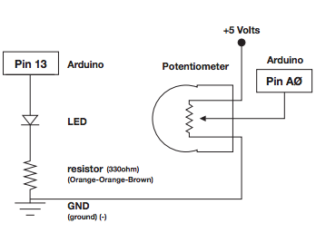
Circuit schematic
The left side of the schematic is the same as the previous circuit.
We’re adding a potentiometer to control the blink rate of the LED.
We’re running 5V across the outer pins of the pot. The middle pin of the potentiometer will be connected to analog input pin 0.
Note: All analog pins on the Arduino are INPUT pins. Digital pins can be INPUT or OUTPUT pins.

Slide 45
Design it!

Slide 47
Create the sketch
int sensorPin =0;
int ledPin =13;
void setup() {
Serial.begin(9600);
pinMode(ledPin, OUTPUT);
}
void loop() {
int sensorValue;
sensorValue = analogRead(sensorPin);
digitalWrite(ledPin, HIGH);
delay(sensorValue);
digitalWrite(ledPin, LOW);
delay(sensorValue);
Serial.println(sensorValue);
}
Notes:
In this sketch we’ll start to use variables to name and store numbers that change. In this case the changing number is the analog input from the potentiometer.
Variables can be different data types such as integers, boolean, etc. See http://arduino.cc/en/Reference/VariableDeclaration. Integers, which we are using here, are whole numbers that can be negative.
If you declare variables outside of a function, they are called “global variables” and can be seen by all the functions. In general, you want to limit the scope of the variables, but in this case global variables are fine.
Variables must be “declared” before you can use them. In this sketch we are declaring three integer variables, sensorPin, ledPin, and sensorValue. The variable sensorPin will be used to refer to analog input pin 0. The variable ledPin will be used to refer to digital pin 13. Sometimes it’s easier to follow a sketch if we use variable names instead of just numbers, so we often name the pins we are using. The variable sensorValue will be used to store values from analog input pin 0.
You might notice in the setup() function that we are setting the digital pin named ledPin to an OUTPUT, but we aren’t setting the analog pin named sensorPin to anything. Why is this? This is because Arduino’s digital pins can be either input or output signals, but the analog pins can only input signals. In other words, an Arduino can interpret (input) analog information like the turning of a knob, but it can’t control that knob to turn (output) in the same continuous way.
You’ll also notice in the setup() function that we declared a function Serial.begin(9600). This just sets the data rate in bits per second (baud) for serial communication. We do this because we’re going to watch the serial monitor to see how values change when the pot knob is turned. In the loop() function we call another function Serial.println(sensorValue) to print the values on the serial monitor as text we can read. In this case, it will print the values that correspond to the voltage of the potentiometer. Question: what is the range going to be on the serial monitor? Remember what we talked about with analog and digital values. We could also use Serial.println() to print the values for the ledPin. What is the range going to be in this case?
Play with turning the knob as you watch what’s happening on the serial monitor. Do you see how when the knob is turned all the way to the left, the value on the serial monitor is 0? That corresponds to a voltage of 0. Do you see how when the knob is turned all the way to the right, the value on the serial monitor is 1023? That corresponds to a voltage of 5V. And then there are many values in between. So, you can see how a potentiometer is used as a voltage divider because it simply divides a given voltage.
So what’s happening in the loop() function? The variable sensorValue is storing the voltage values (from 0 to 1023) from the pot, which vary as the knob is turned. The knob all the way to the left is 0V, and the knob all the way to the right is 5V (1023). The LED blinks for the same amount of time as the sensorValue. So, if the knob is all the way turned to the left, the LED doesn’t actually blink because the delay is 0. If the knob is turned all the way to the right, the LED blinks and pauses for 1023 milliseconds, or about one second.
Experiment:
Now, is this what you’d expect, or does the knob feel a little “backward” to you? How do you need to reconfigure either the pot or the code so that as you turn the knob from left to right the LED blinks more rapidly?

Slide 48
Circuit #3 photo resistor (light sensor)
Photoresistors change resistance based on how much light the sensor receives.
Use our photo resistor in a “voltage divider” configuration. Output:
High voltage = lot of light
Low voltage = little light
Brighten and dim an LED based on the light level picked up by the photo resistor.
So…in this case we’re using a digital signal to control an analog output.
Wait! I thought Arduino didn’t have a digital-to-analog converter?!?
Notes:
We’ve already played with a potentiometer, which varies resistance based on the twisting of a knob. Here we’ll be using a photo resistor, which changes resistance based on how much light the sensor receives.
Arduino’s analog input pins can’t directly measure resistance (rather, they read voltage), but we can measure voltage changes by building a voltage divider with the photoresistor.
The voltage divider will output a high voltage when it’s getting a lot of light and a low voltage when it’s not, and a variety of values in between.
We’ll use this information about the voltage change across the photo resistor to brighten and dim and LED based on the light level picked up by the sensor.
So, in this case we’re using a digital signal to control an analog output. But Arduino doesn’t have a digital-to-analog converter. We’ll have to use a trick!

Slide 49
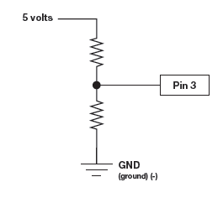
Resistive sensors & Voltage Dividers
Resistor in disguise!
Arduino measures voltage, not resistance. Need a voltage divider:
Consists of two resistors.
The “top” resistor is the sensor.
The “bottom” resistor is a normal, fixed resistor (usually 10 KΩ).
Top resistor
Bottom resistor
When top resistor is connected to 5V and the bottom resistor to ground, the middle will output a voltage proportional to the values of the two resistors.
This is how we use resistive sensors to measure voltage.
Notes:
Many of the sensors you’ll use (like potentiometers, photoresistors, and temperature sensors, to name a few) are “resistors in disguise.” Their resistance changes in proportion to whatever they’re sensing.
As we discussed before, Arduino’s analog input pins measure voltage, not resistance, But we can use resistive sensors to measure voltage changes by building a voltage divider. A voltage divider consists of two resistor. The “top” resistor is the sensor you’re using (like a photoresistor or temperature sensor). The bottom resistor is a normal, fixed resistor (usually 10 k-ohms). When the top resistor is connected to power and the bottom resistor is connected to ground, the middle of the voltage divider will output a voltage that is proportional to the values of the two resistors.

Slide 50
Pulse Width Modulation
Sneaky trick Arduino uses to simulate the output of an analog signal.
Arduino is so fast it can blink a pin on and off 1,000 times per second.
PWM pins also vary amount of time blinking pin spends on HIGH vs. LOW.
Use function: analogWrite(pin, value)
Choose a pin marked by a ~
Value is the duty cycle
0 = always OFF
255 = always ON
127 = on HALF the time
(50% duty cycle)
Notes:
So back to our issue with wanting to convert digital to analog. In this case we want to use the digital signal from our Arduino to change the brightness of an LED. So, we need to be outputting some varying voltage level. But our Arduino isn’t built for that.
We employ a trick called pulse width modulation (PWM). Because the Arduino is so fast, it can blink a pin on and off almost 1,000 times per second. Certain Arduino pins (those that can do PWM, indicated with a ~ next to them) go one step further by varying the amount of time the blinking pin spends HIGH vs. LOW. If it spends most of its time HIGH, a LED connected to that pin will appear bright. If it spends most of its time on LOW, the LED will look dim. Because the pin is blinking much faster than your eye can detect, the Arduino creates the illusion of a true analog output.
We use the function analogWrite() to do PWM. The first argument is the pin, and the second is the duty cycle (see next slide).

Slide 51
Pulse Width Modulation (PWM)
10% duty cycle
50% duty cycle
90% duty cycle

Slide 52
Circuit schematic
The left side of the schematic is almost the same as the previous circuits. What’s changed?
Notes:
On the left side of the circuit schematic, the positive lead of the LED has been moved to Pin 9 (previously it was connected to Pin 13). This is because Pin 9 does PWM.

Slide 53
Design it!

Slide 55
CREATE THE SKETCH
const int sensorPin=0;
const int ledPin=9;
int lightLevel, high=0, low=1023;
void setup() {
pinMode(ledPin, OUTPUT);
Serial.begin(9600);
}
void loop() {
lightLevel = analogRead(sensorPin);
autoTune();
analogWrite(ledPin, lightLevel);
Serial.println(lightLevel);
}

Slide 56
CREATE THE SKETCH
void autoTune()
{
if(lightLevel<low)
{
low=lightLevel;
}
if(lightLevel>high)
{
high=lightLevel;
}
lightLevel=map(lightLevel, low+30, high-30, 0, 255);
lightLevel=constrain(lightLevel, 0, 255);
}

Slide 57
CIRCUIT #4: TEMPERATURE SENSOR
Temperature sensors are used to measure ambient temperature.
Sensor we’re using has three pins – positive, ground, and a signal. For every centigrade degree it reads, it outputs 10 millivolts.
We’ll integrate the temperature sensor with Arduino and use the serial monitor to display the temperature.

Slide 58
CIRCUIT SCHEMATIC

Slide 59
Design it!

Slide 61
Create the sketch
const int temperaturePin = 0;
void setup() {
Serial.begin(9600);
}
void loop() {
float voltage, degreesC, degreesF;
voltage = getVoltage(temperaturePin);
degreesC = (voltage - 0.5) * 100.0;
degreesF = degreesC * (9.0/5.0) + 32.0;
Serial.print("voltage: ");
Serial.print(voltage);
Serial.print(" deg C: ");
Serial.print(degreesC);
Serial.print(" deg F: ");
Serial.println(degreesF);
delay(1000);
}
float getVoltage(int pin)
{
return(analogRead(pin) * 0.004882814);
}
Notes:
So, where do you think the formula for degrees C came from?
The specification sheet for the temperature sensor, of course! See next slide.

Slide 62
Output Voltage vs. Temperature for TMP36
http://www.analog.com/media/en/technical-documentation/data-sheets/TMP35_36_37.pdf
Notes:
Look at line b, which corresponds to TMP36 (the version of the temperature sensor we are using). At 100˚C, the output voltage is about 1.5 V.
Using this point of information, we can write a function for degrees C as a function of output voltage: Degrees C = (Output voltage – 0.5) * 100. From the spec sheet, it looks like this function will hold true for any temperature from -50˚C to 125˚C.

Slide 63
Congratulations!
You just learned about:
Microcontroller basics
Ohm’s Law
Analog vs. digital signals
Interpreting circuit schematics
Designing circuits
Basic coding
Voltage dividers
Pulse Width Modulation
LEDs
Three types of variable resistors
How to use sensors and data sheets

Slide 64
Where to go from Here?

Slide 65
Sparkfun
www.sparkfun.com

Slide 66
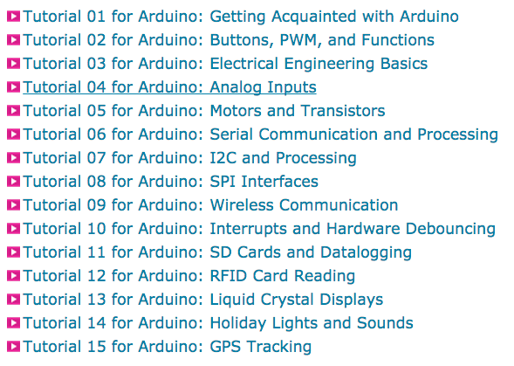
Jeremy Blum Tutorial Series
www.element14.com

Slide 67
Arduino Website

Slide 68
instructables

Slide 69
Questions
Dr. Lauren Cooper
lcooper@mines.edu
Thank you for your participation!

