Slide 1
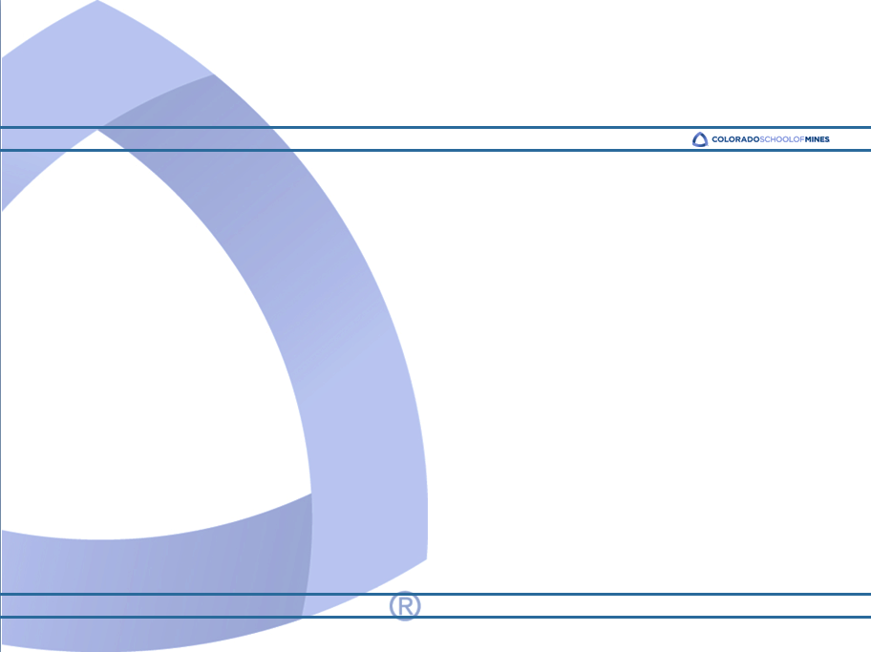
Presentation at AIMS
Willy Hereman
Department of Applied Mathematics and Statistics
Colorado School of Mines
Golden, CO 80401
USA
Tuesday, April 22, 2014, 16:10

Slide 2
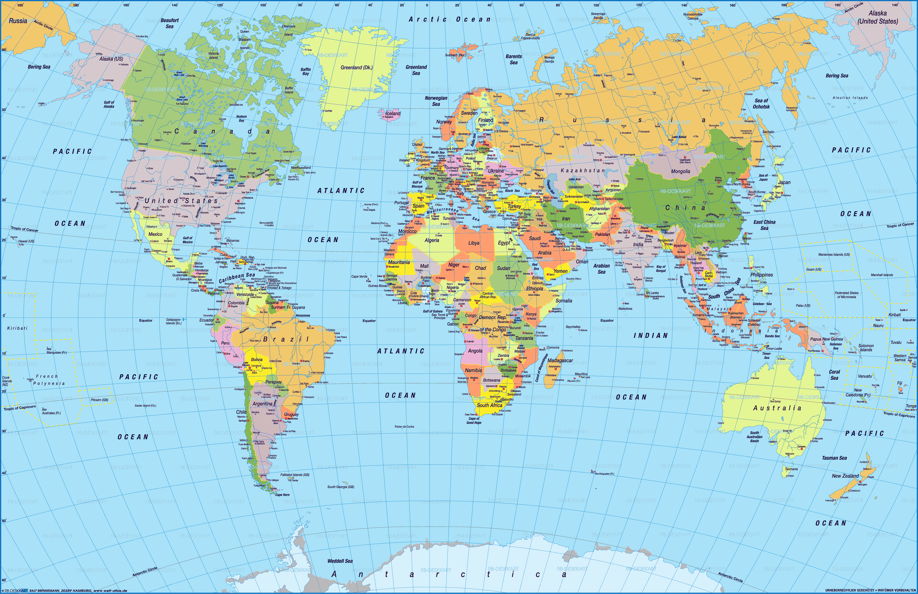
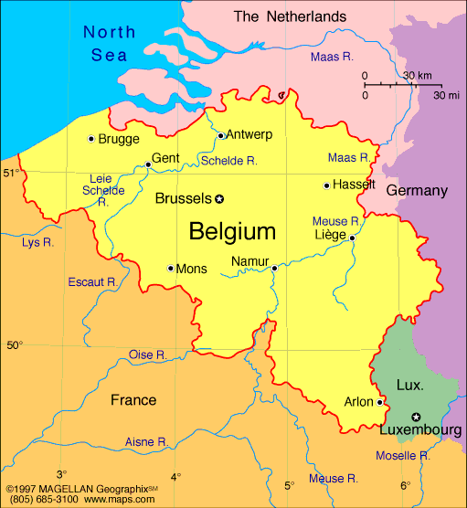

Slide 3
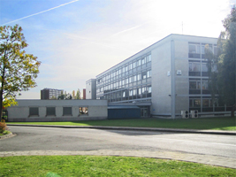
University of Ghent, Belgium
Postdoctoral Researcher, Institute for Theoretical Mechanics 1982-86
PhD Applied Mathematics 1982
Thesis: Acousto-optics
Advisor (mentor): Robert Mertens
Teaching Diploma 1976
MS Applied Mathematics 1976
Thesis: Dynamical systems
BS Mathematics 1974
Taught courses in Theoretical Mechanics

Slide 5
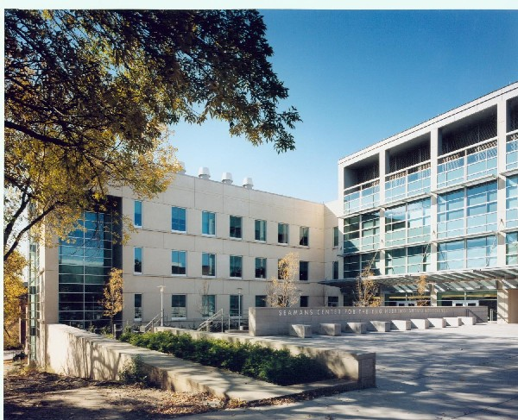
The University of Iowa
Visiting Scholar with
NATO Research Fellowships
Department of Electrical and Computer Engineering 1983–84 and 1985-86

Slide 6
At The University of Iowa
Worked in acousto-optics laboratory of Adrian Korpel (great mentor)
Research in linear and nonlinear waves
Developed a direct method to solve nonlinear PDEs (soliton theory)

Slide 8
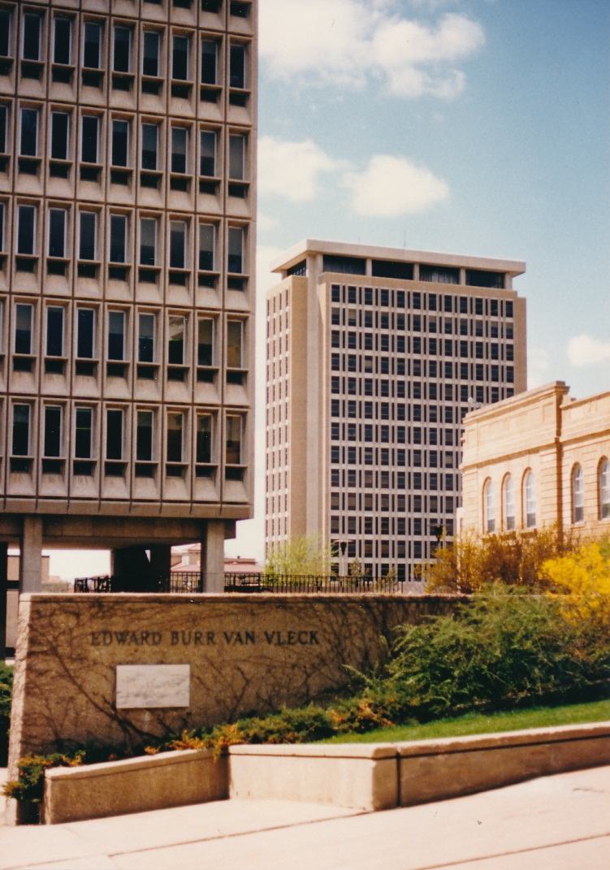
University of Wisconsin-Madison
Van Vleck Visiting Assistant Professor
Department of Mathematics
1986-89

Slide 9
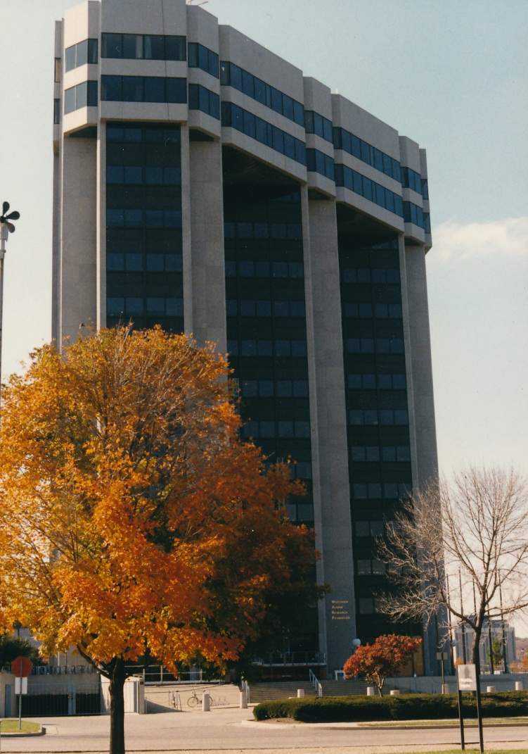
University of Wisconsin-Madison
Visiting Scholar
Center for the Mathematical Sciences
1986-89
Modeling Information Processing And Control group of David Russell (great mentor)

Slide 10
At UW-Madison
Started using symbolic software (Macsyma)
Wrote code for integrability testing of nonlinear differential equations (Painlevé test)
Research on nonlinear wave phenomena
Lie symmetries (CRM, Montréal)
Taught linear and nonlinear waves , calculus of variations and control theory
Taught differential equations and linear algebra

Slide 12
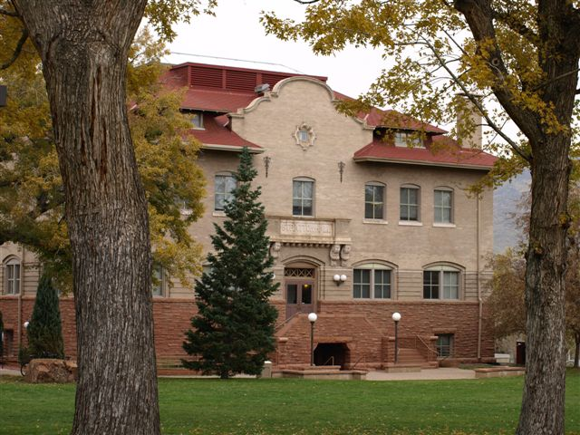
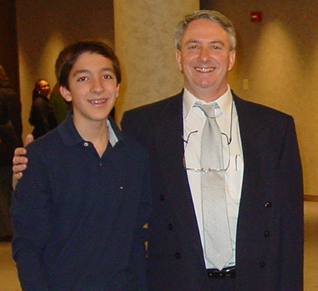
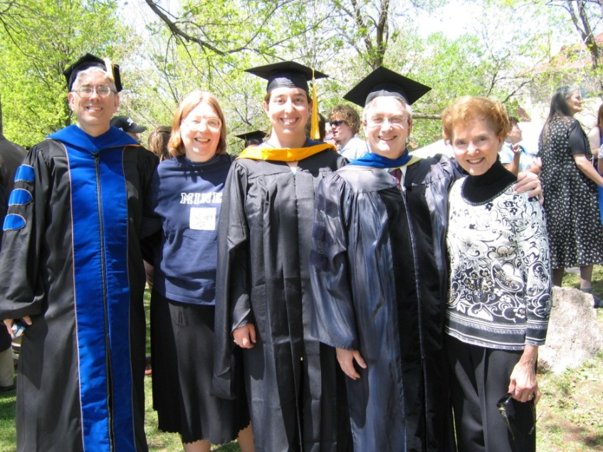
Colorado School of Mines

Slide 13
Colorado School of Mines
Head Appl. Maths & Stats August 2012- present
Interim Head of AMS August 2011-August 2012
Professor 1998-present
Tenured 1995
Associate Professor 1989-1998

Slide 14
At the Colorado School of Mines
Taught 22 different courses (I enjoy teaching!)
Specialty courses: wavelets, nonlinear waves, modeling with symbolic software (Mathematica)
3 PhD students (academics in Irbid, Jordan, Ankara, Turkey, and Chadron, Nebraska)
8 Master students
Currently: 1 PhD
42 Research Experiences for Undergraduate (REU) students (20% female)

Slide 15
At the Colorado School of Mines
Scattering of waves from rough surfaces
Theory and applications of wavelets
Integrability and exact solutions of nonlinear PDEs
Symmetries and conservation laws
Best known for my Mathematica codes for nonlinear differential and lattices equations

Slide 16
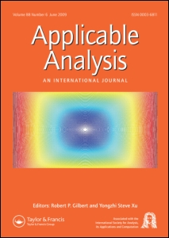
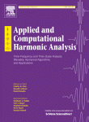
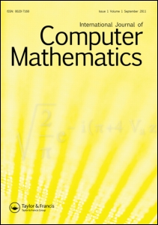
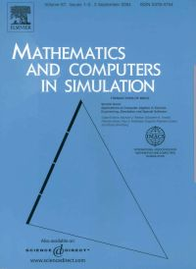
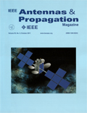
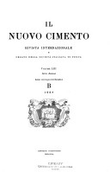
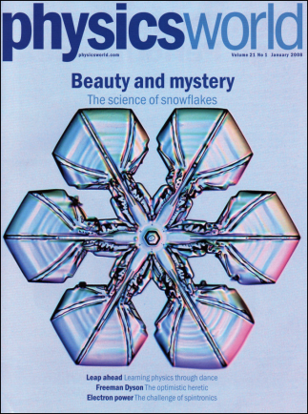
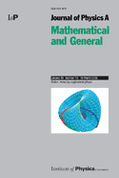
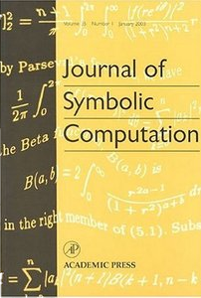
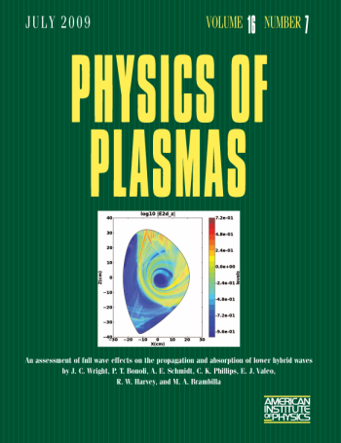
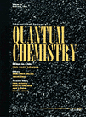
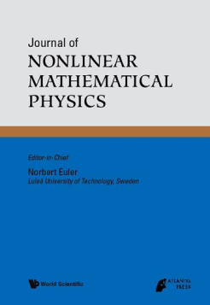
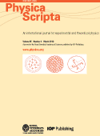
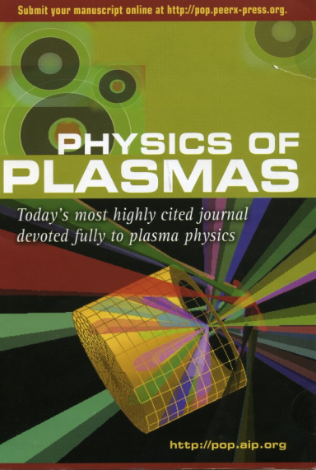
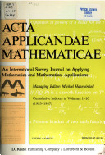
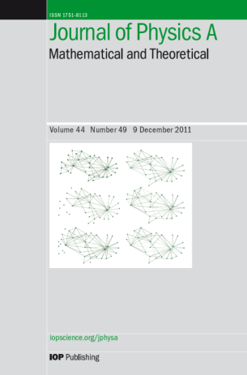
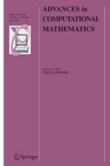
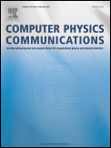
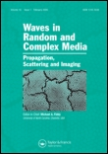
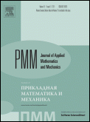
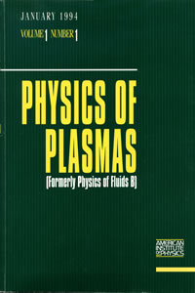
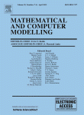

Slide 17
Notes:
beginning

Slide 18
Course at AIMS Feb-March 2008
Nonlinear Dynamical Systems with Applications to Mathematical Biology
Willy Hereman and Kesh Govinder (Univ. KwaZulu-Natal, Durban)

Slide 19
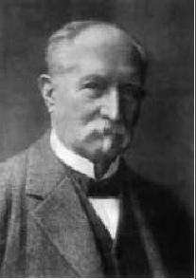
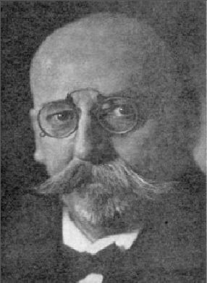
Research Focus
Diederik Korteweg
(1848-1941)
Gustav de Vries
(1866-1934)
$$u_{t}+6 uu_{x}+u_{xxx}=0$$
for u(x,t)

Slide 20
Research Focus
Interacting solitons

Slide 21
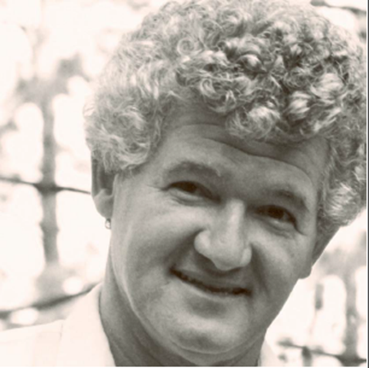
Research Focus
Complete integrability
Continuous to discrete equations
3D conservation laws
Exact solutions to nonlinear PDEs
Symmetries & recursion operators
Homotopy operators
Lax pairs
Development of symbolic software
Peter Lax
(1926-)

Slide 22
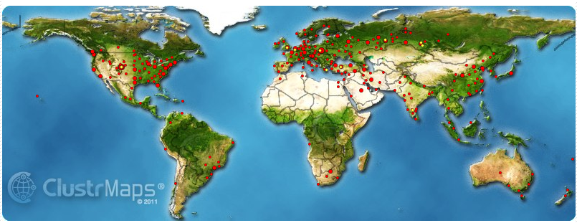
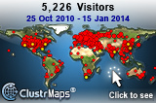
http://inside.mines.edu/~whereman
whereman@mines.edu
Papers, presentations, software, ….

